Slide 1
Operations Research
First Assignment
Volkan İlbeyli
040100118

Slide 2

How do you define problem?
A problem basically can be thought of a puzzling circumstance or any situation which requires a solution which leads to a specific purpose.

Slide 3
The process of problem solving
We can consider 5 steps for solving a problem[1]:
Observation
Problem Definition
Modeling
Solution
Implementation

Slide 4

Observation
The purpose of observation is to determine if the problem exists. This is done by observing the system closed to external disturbances in a continuous fashion until the problem occurs.

Slide 5
Problem Definition
Once the problem is observed, problem definition can be done by 2 steps:
Exploring resources (constraints)
Defining a goal (output)

Slide 6
Modeling
A model can be thought as the matehmatical or abstract representation of the problem (functions and constraints).

Slide 7

Solution
More abstract or simple the model, more powerful the solution.

Slide 8
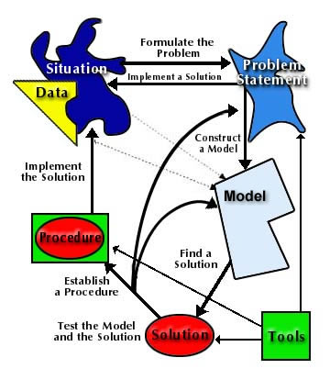
Implementation
Realization of the solution.
In any phase of the problem solving, feedback is important and determines the direction of the process.
Source: http://www.me.utexas.edu/~jensen/ORMM/models/unit/or_method/process.html

Slide 9
What’s the meaning of «Decision» ?
Decision, in my own words, is picking one among alternatives based on some conditions.

Slide 10
... And «Bounded Rationality»
In decision making, there are 3 constraints
Limited information and limited relevancy
Human mind capacity is limited to process all the relevant information
Limited time
Proposed by Herbert Simon.
Making satisfactory decisions rather than optimal ones.

Slide 11
References
Zeepedia, Operations Research Handouts
http://www.zeepedia.com/read.php?introduction_model_solution_implementation_of_results_operations_research&b=66&c=1
Jensen, Paul. Operations Research Model & Methods, Internet
http://www.me.utexas.edu/~jensen/ORMM/models/unit/or_method/process.html
Seven Steps to Problem Solving
http://www.pitt.edu/~groups/probsolv.html
Castello, B. The Operations Research Problem Solving Process
http://www.ams.jhu.edu/~castello/625.414/Handouts/Problem%20Solving%20Process.pdf
Business Dictionary, Internet Dictionary
http://www.businessdictionary.com/definition/bounded-rationality.html
Selten, R. What is Bounded Rationality?
http://www.wiwi.uni-bonn.de/sfb303/papers/1999/b/bonnsfb454.pdf

